Slide 1
System call

Slide 2
System call
A system call is a mechanism that provides the interface between a process and the operating system
A system call is a way for programs to interact with the operating system.
A computer program makes a system call when it makes a request to the operating system’s kernel.
System call provides the services of the operating system to the user programs via Application Program Interface(API)

Slide 3
Why do we need System Calls?
Following are situations which need system calls in OS:
Reading and writing from files demand system calls.
If a file system wants to create or delete files, system calls are required.
System calls are used for the creation and management of new processes.
Network connections need system calls for sending and receiving packets.
Access to hardware devices like scanner, printer, need a system call.

Slide 4
Types of System calls
Here are the various types of system calls used in OS:
Process Control
File Management
Device Management
Information Maintenance
Communications
Protection

Slide 5
Process Control: This system calls perform the task of process creation, process termination, etc.
Functions:
End and Abort
Load and Execute
Create Process and Terminate Process
Wait and Signed Event
Allocate and free memory
Debugger for determining bugs, single step execution.
Locks for managing access to shared data between processes.

Slide 6
File Management
File management system calls handle file manipulation jobs like creating a file, reading, and writing, etc.
Functions:
Create a file
Delete file
Open and close file
Read, write, and reposition
Get and set file attributes

Slide 7
Device Management:
Device management does the job of device manipulation like reading from device buffers, writing into device buffers, etc.
Functions
Request and release device
Logically attach/ detach devices
Get and Set device attributes

Slide 8
Information Maintenance
It handles information and its transfer between the OS and the user program.
Functions:
Get or set time and date
Get system data, set system data
Get process and device attributes

Slide 9
Communication: These types of system calls are specially used for inter-process communications.
Functions:
Create, delete communications connections
Send, receive message
Help OS to transfer status information
Attach or detach remote devices
Protection
Control access to resources
Get and set permissions
Allow and deny user access

Slide 10
Examples of Windows and Unix System Calls
Standard C Library Example
C program invoking printf() library call, which calls write() system call

Slide 11
System call for process management
Process creation, Termination, Waiting

Slide 12
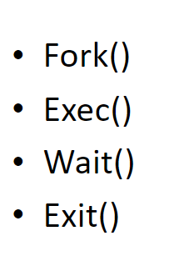
Process System call

Slide 13
fork()
Will spawn a new child process which is an identical process to the parent except that has a new system pid
The process is copied in memory from the parent and a new process structure is assigned by the kernel

Slide 14
fork ()
System call fork() is used to create processes.
It takes no arguments and returns a process ID. The purpose of fork() is to create a new process, which becomes the child process of the caller.
After a new child process is created, both processes will execute the next instruction following the fork() system call.
Therefore, we have to distinguish the parent from the child.
This can be done by testing the returned value of fork():
The return value to the parent process will be the Process ID (PID) of the child, whilst the child will get a return value of 0.

Slide 15
If fork() returns a negative value, the creation of a child process was unsuccessful.
fork() returns a zero to the newly created child process.
fork() returns a positive value, the process ID of the child process, to the parent. The returned process ID is of type pid_t defined in sys/types.h. Normally, the process ID is an integer. Moreover, a process can use function getpid() to retrieve the process ID assigned to this process

Slide 16
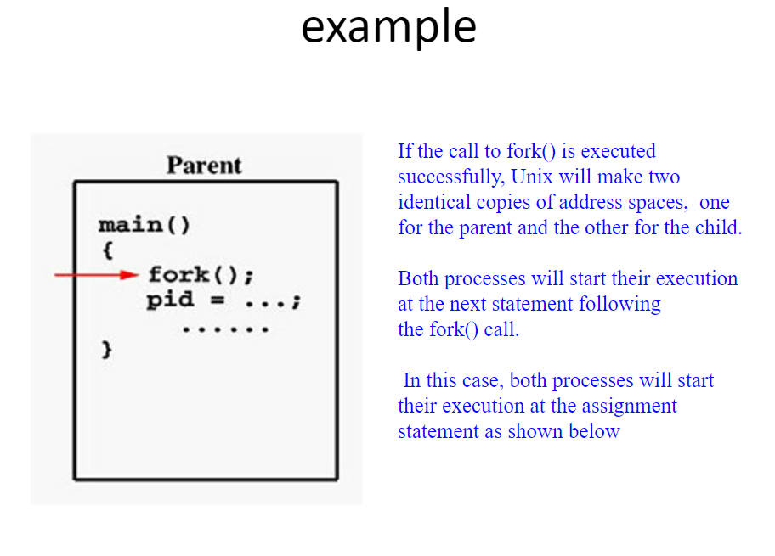

Slide 17
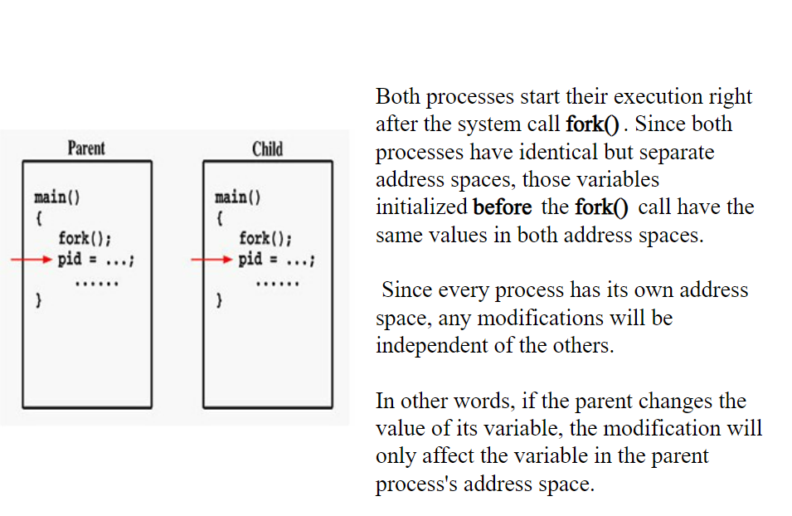

Slide 18
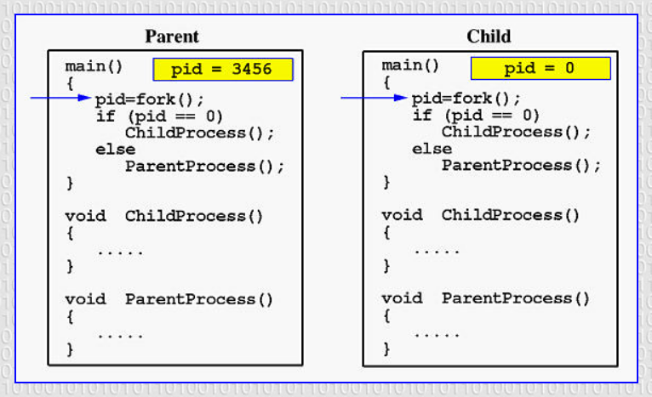

Slide 19
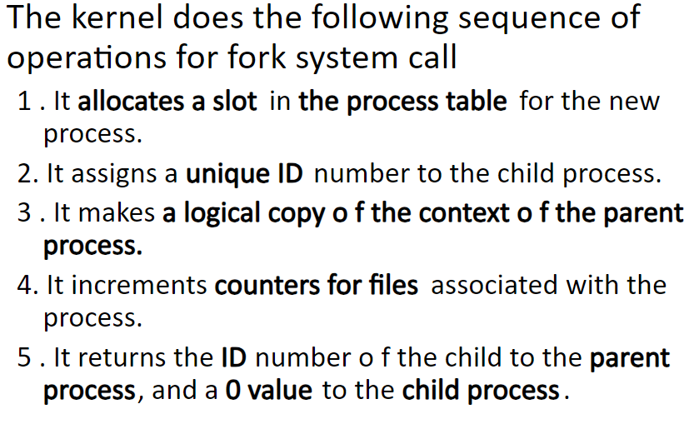

Slide 20
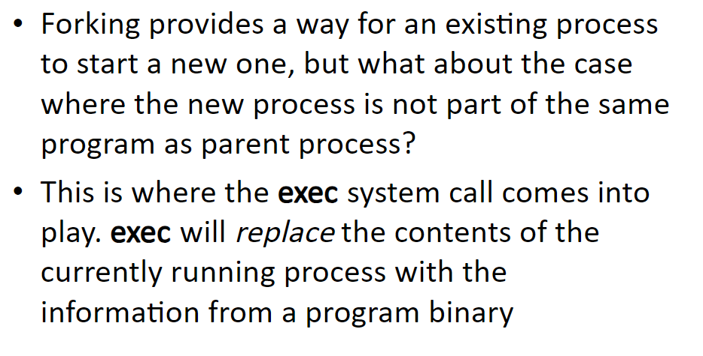

Slide 21
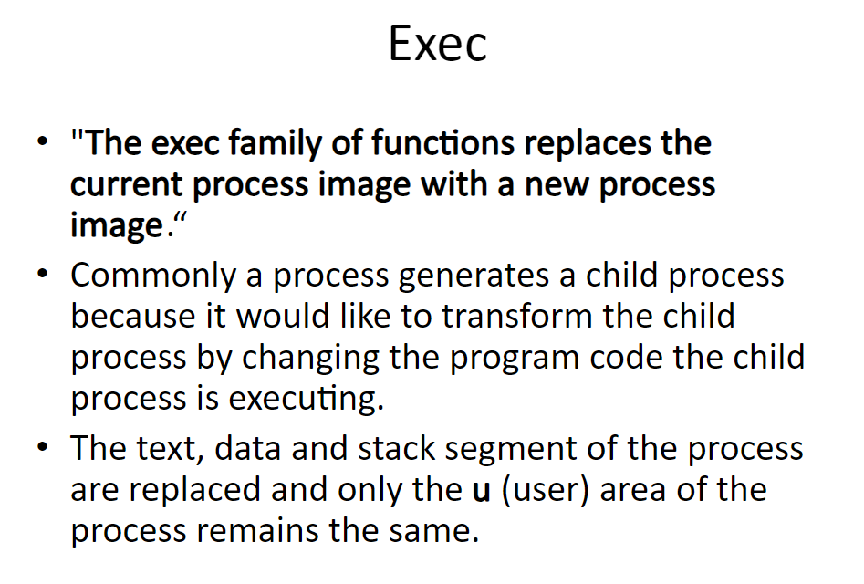

Slide 22
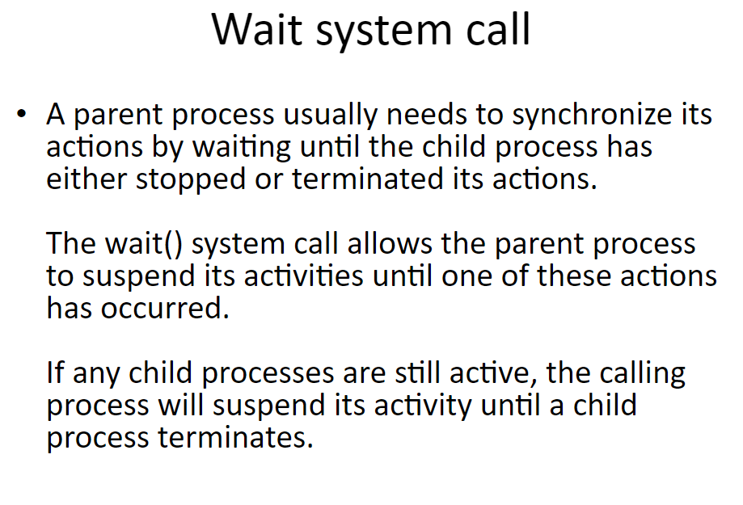
An orphan is a child process that continues to execute after its parent has finished execution (or died) to avoid this problem, the parent should execute a wait system call

Slide 23
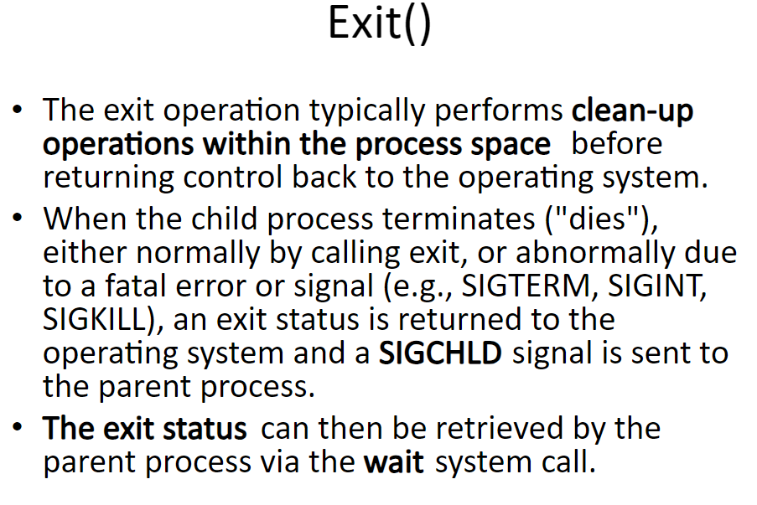

Slide 24
